Slide 1
Executive Summary Airline Safety and Trends Analysis

Slide 2
Context
To provide an in-depth analysis of airline safety trends, comparative safety data, and insights into passenger traffic, aimed at addressing negative media coverage and reinforcing the safety of air travel.

Slide 3
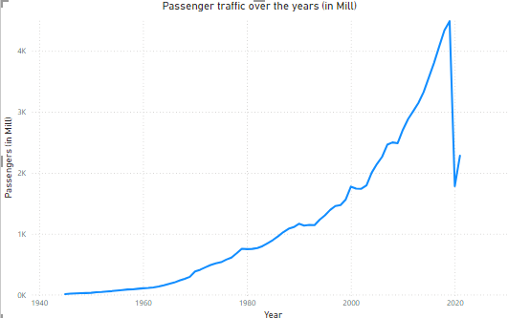

Temporal Trends in Passenger Traffic
Key Points:
Steady growth in passenger traffic over the years, with a noticeable dip during the COVID-19 pandemic.
Resilience in air travel demand post-pandemic, indicating recovery and long-term industry strength.
Visualization: Line chart of passenger traffic over time.
Insight: The overall trend demonstrates robust passenger traffic growth, suggesting confidence in air travel.

Slide 4
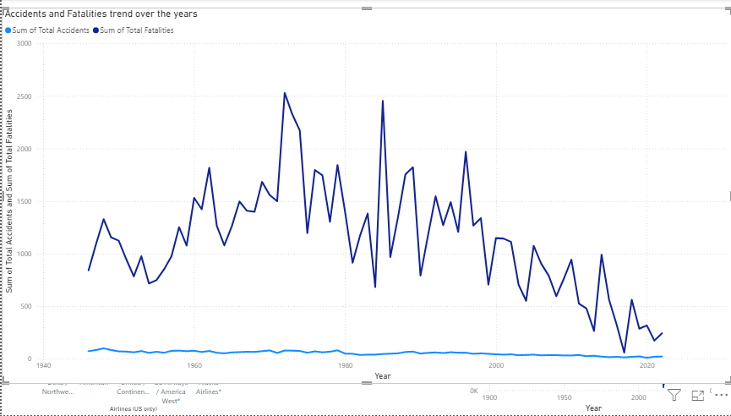
Safety Performance Over Time
Key Points:
Analysis of accident and fatality rates over the decades.
Consistent decline in fatalities despite fluctuations in accident rates.
Visualization: Line Graph of Accidents and Fatalities over the years
Insight: Significant safety advancements in the airline industry, with enhanced safety measures and technologies.

Slide 5
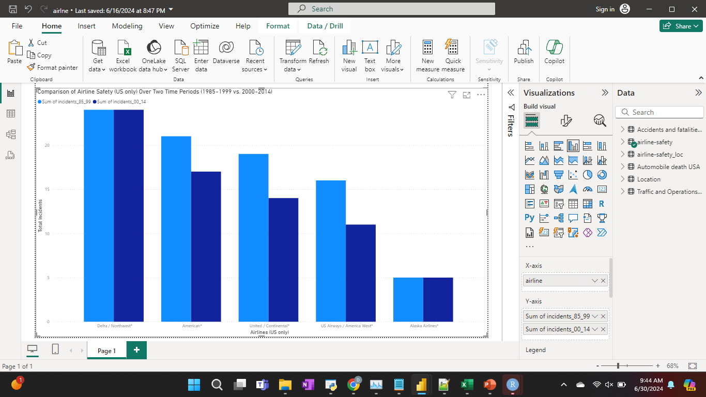
Comparative Safety Analysis (US Only)
Key Points:
Comparison of safety performance between two periods: 1985-1999 and 2000-2014.
Marked reduction in accidents and fatalities in the latter period.
Visualization: Clustered Column Chart for comparison between two periods.
Insight: Effective safety improvement initiatives have led to a safer industry, showcasing commitment to passenger safety.

Slide 6
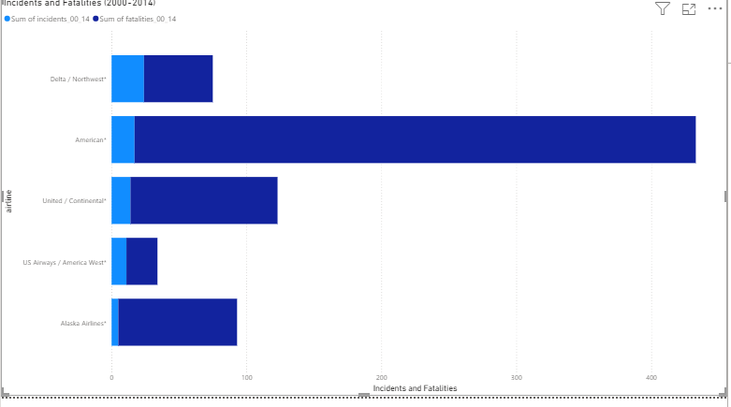
Incident Distribution Among Airlines (US only)
Key Points:
Distribution of incidents and fatalities across different airlines from 2000-2014.
Variances in safety records among carriers.
Shows Delta has maximum number of accidents but least number of Fatalities.
Visualization: Stacked Bar Graph to show comparison between airline records.
Insight: Identifies airlines with better or worse safety records, enabling targeted safety interventions

Slide 7
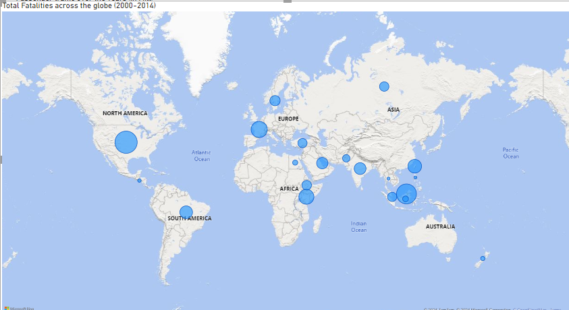
Geospatial Analysis of Fatalities
Key Points:
Mapping global fatalities to identify geographical hotspots.
Southeast Asia highlighted as a region of interest.
Visualization: Global Map Visualization (Fatalities across globe)
Insight: Understanding global safety disparities to enable targeted safety improvements and resource allocation.

Slide 8
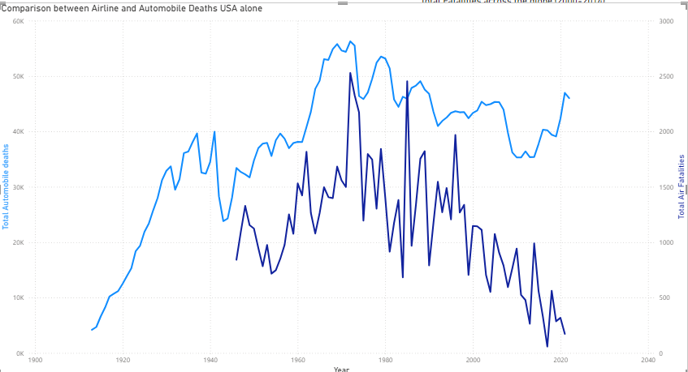
Comparison with Automobile Fatality Rates
Key Points:
Comparison of U.S. automobile fatality rates with airline fatality rates.
Stark contrast in safety risk between air travel and ground transportation.
Air travel is less risky and fatalities are declining.
Visualization: Integrated Data Visualization using Supplemental data for automobile fatalities across USA.
Insight: Reinforces the safety superiority of air travel, countering negative media narratives.

Slide 9

Conclusion

Slide 10

Summary of Findings:
Communication Approach
Key Points:
Air travel is less risky, and fatalities are declining. Airline passenger traffic shows resilience and growth.
Significant advancements in airline safety over the decades.
Comparative safety analysis highlights effective safety initiatives.
Incident distribution identifies variances among airlines.
Geospatial analysis pinpoints regions requiring targeted interventions.
Air travel remains significantly safer than automobile travel.
Leverage these findings in external communications to counter negative media coverage.
Safeguards
Continue to monitor and improve safety measures.
Be Tactical
Address geographical safety disparities with targeted interventions.
Recommendations

Slide 11

Thank you
Deeksha Chawla

